Slide 1
THE GLOBAL,
RELIABLE
INNOVATOR

Slide 2
Agenda
BekaertDeslee Overview
BD Hiring Program
Q&A

Slide 3
Agenda
BekaertDeslee Overview
BD Hiring Program

Slide 4
BekaertDeslee Overview
贝卡特德思丽公司介绍
贝卡特德思丽床垫面料工艺流程
贝卡特德思丽设计
贝卡特德思丽睡眠方案

Slide 5
BekaertDeslee
贝卡特德思丽
founded 1892
1892年成立
mattress textiles
mattress covers better sleep solutions
专注生产床垫面料
床垫套
全面的睡眠解决方案 隶属德国Haniel集团
2500+ employees
2500+员工
320+ MIO € turnover
年收入3.2亿欧元
Textiles for 110.000 mattresses per day. BekaertDeslee
touches 600 million people every night.
每天生产的床垫面料可供
11万张床垫使用
为全球6亿人提供安稳睡眠
10 business units
19 locations worldwide
全球10个业务单元
19个工厂

Slide 6
Better sleep, better life
更好的睡眠 更好的生活
Our passion is to develop tactile, stylish and smart sleep surfaces that will inspire,
comfort and protect you during the night.
贝卡特德思丽隶属于德国哈尼尔集团，拥有百年专业纺织制造技术和经验。我们致力于为客户提供最优质、不同种类的针织和梭织床垫面料。贝卡特德思丽足迹遍布全球，并在中国区拥有两个生产基地（无锡和东莞）。运用先进创新的科学技术，我们为客户提供最专业的睡眠解决方案，并将科技与舒适融入床垫面料中，为亿万消费者带来优质睡眠。秉承绝伦的设计风格，贝卡特德思丽为不同消费群体提供风格多样，独树一帜的床垫面料。

Slide 8
合作品牌

Slide 9
Notes:
19 local jewels on 1 inspiring and supportive motherboard

Slide 10
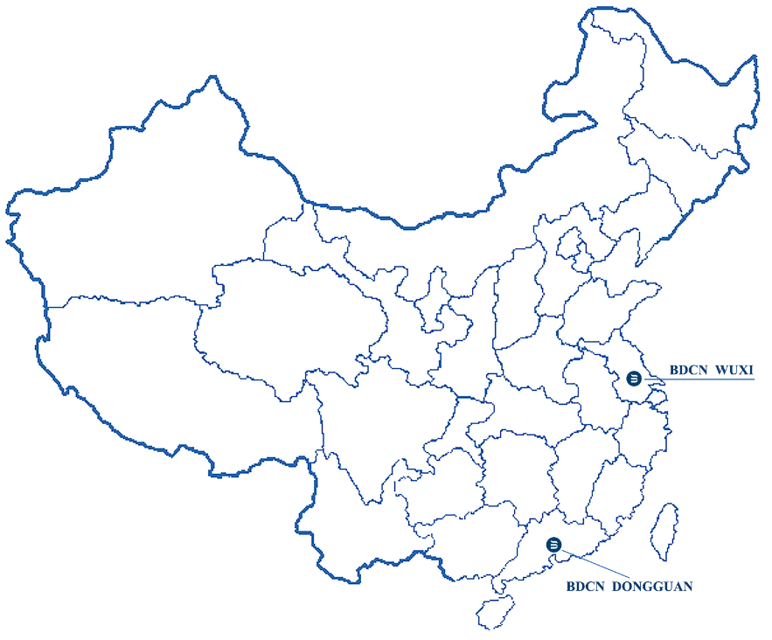
BEKAERTDESLEE CHINA - Facts & figures
Wuxi plant established in 2003 with expansions in 2008 & 2012.
Dongguan plant established in 2011.
Jacquard woven & knitted fabrics.
Wuxi plant: 15,000 m². Dongguan plant: 4,400 m².
Employees: 190
Turnover USD 30 mio (2016) – 200 active customers.
Focus on the domestic market
Focus on the big brands, international and local

Slide 11
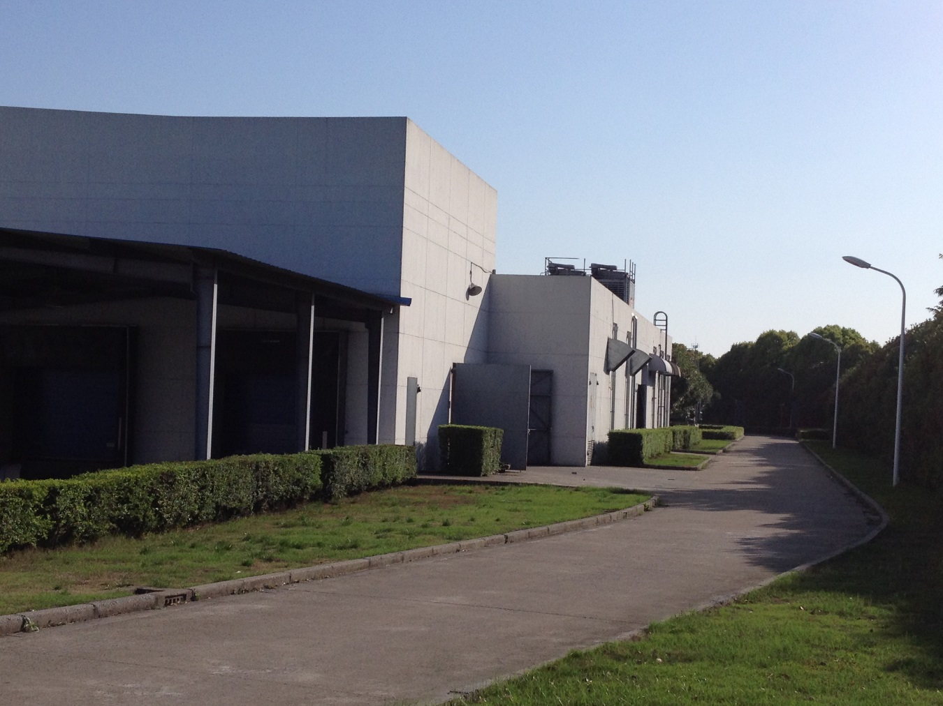
无锡工厂

Slide 12
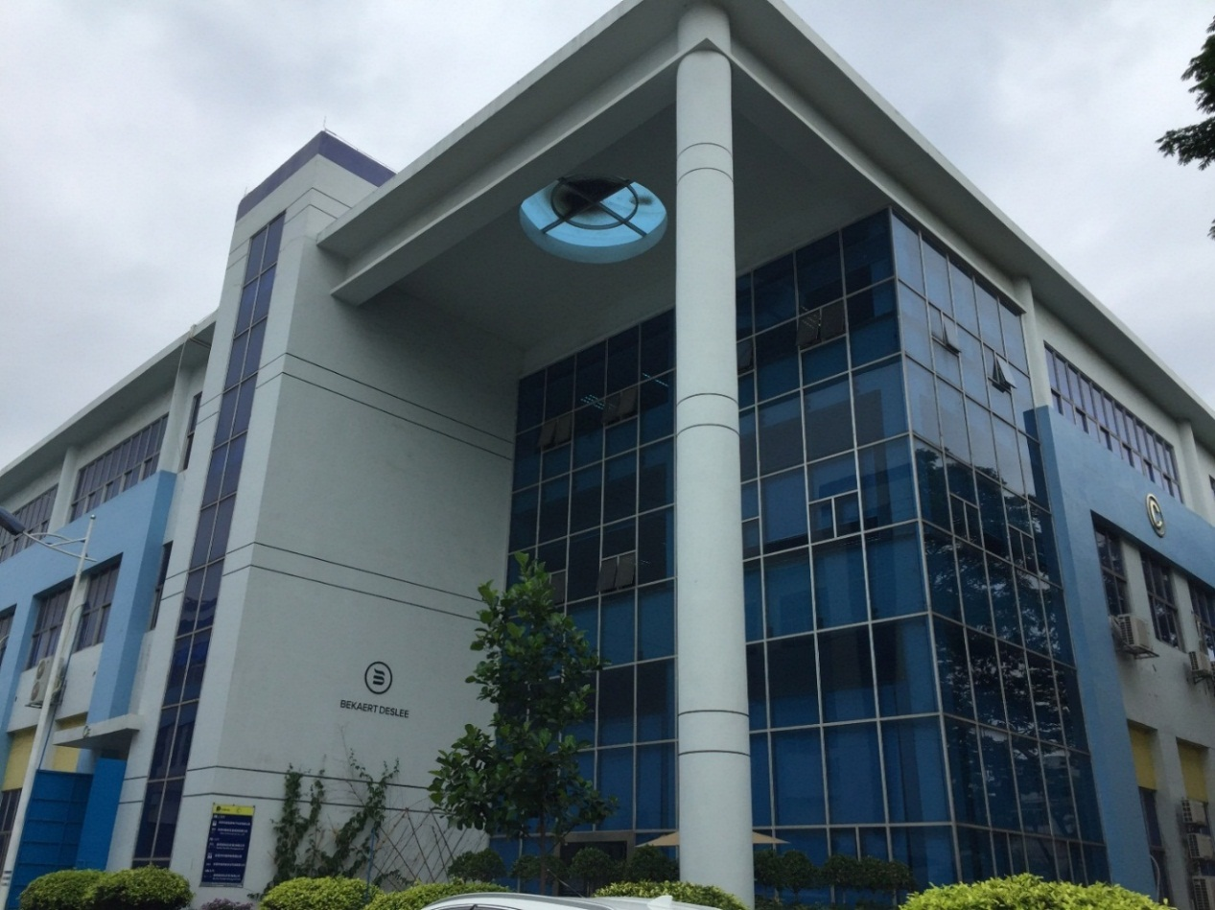
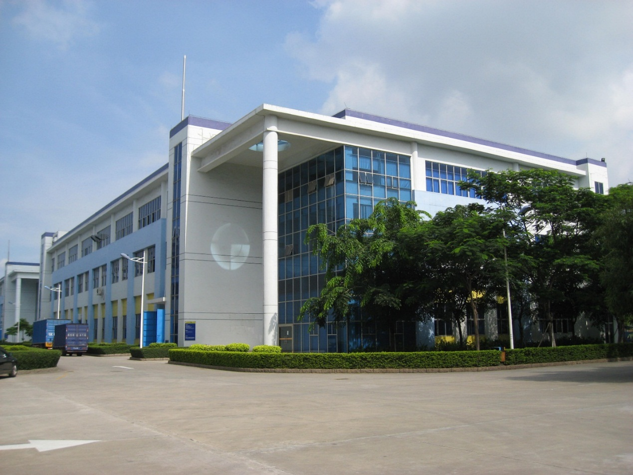
东莞工厂

Slide 13
贝卡特德思丽生产流程

Slide 14
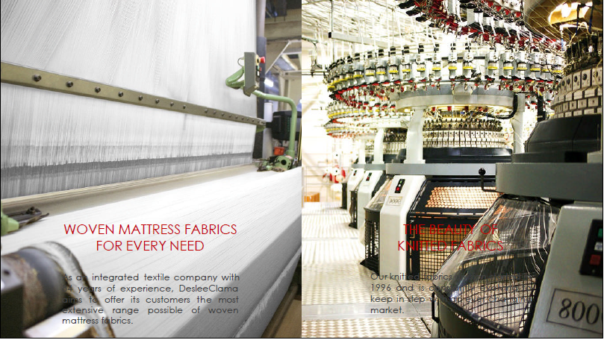
贝卡特德思丽生产流程

Slide 15
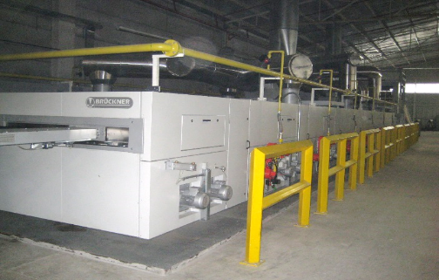
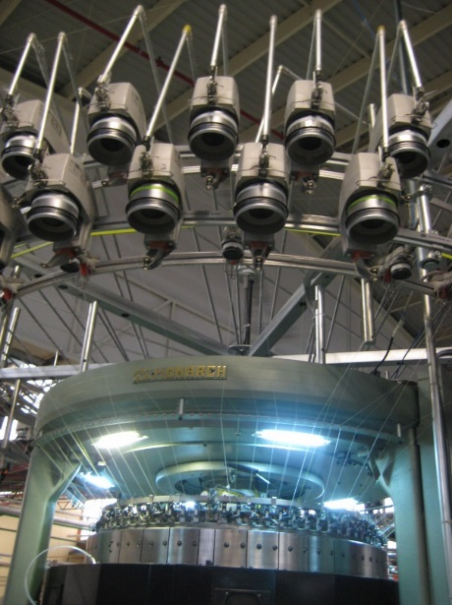
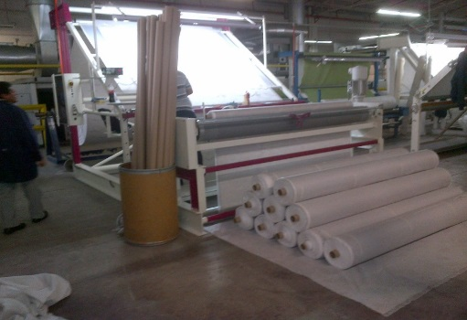
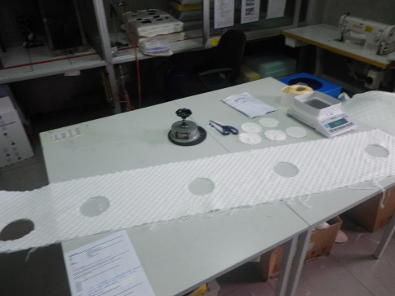
贝卡特德思丽生产流程

Slide 16
梭织

Slide 17
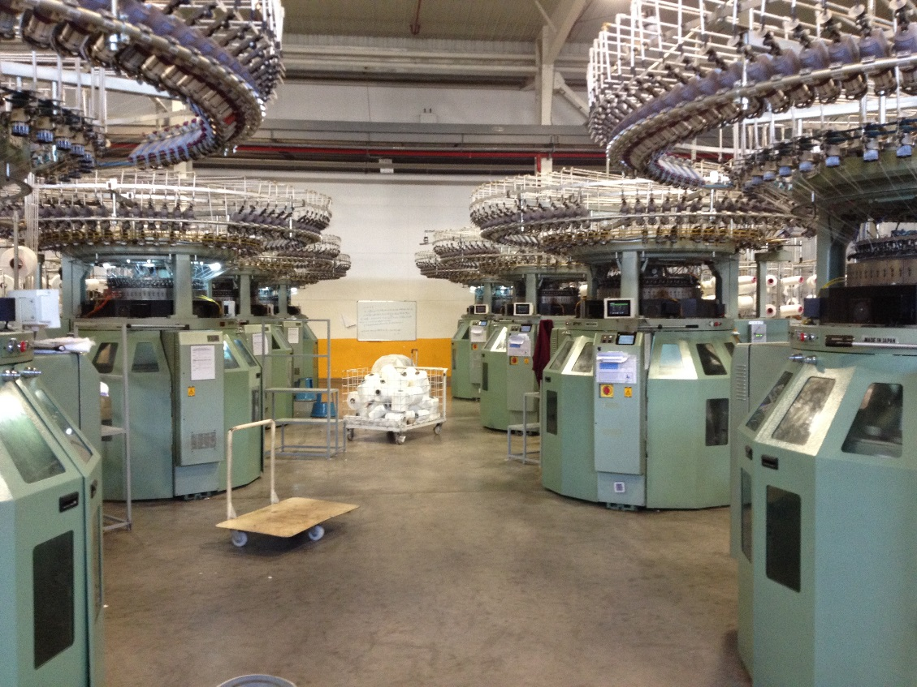
针织

Slide 18
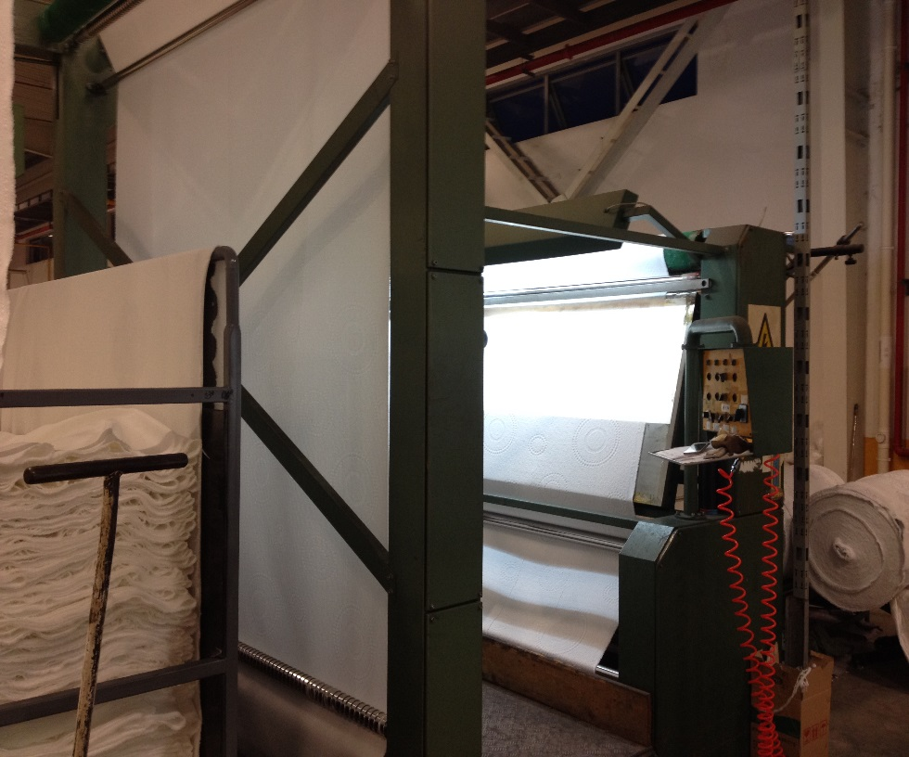
半成品全检

Slide 19
定型

Slide 20
最后全检

Slide 21
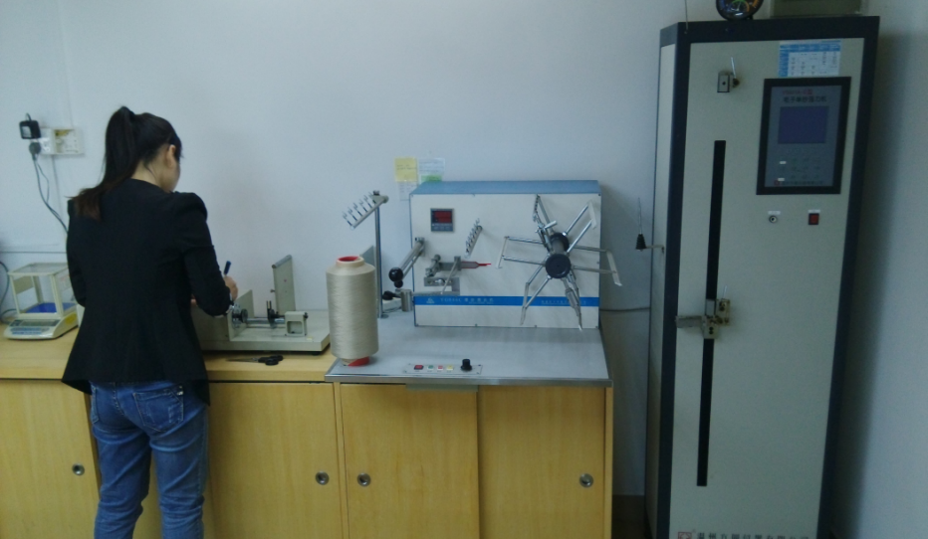
实验室

Slide 22
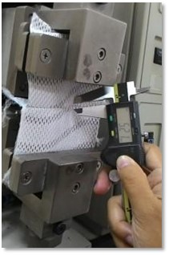
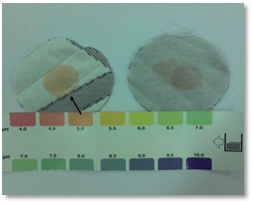
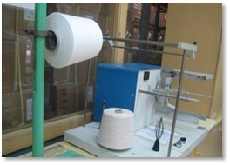
实验室

Slide 23
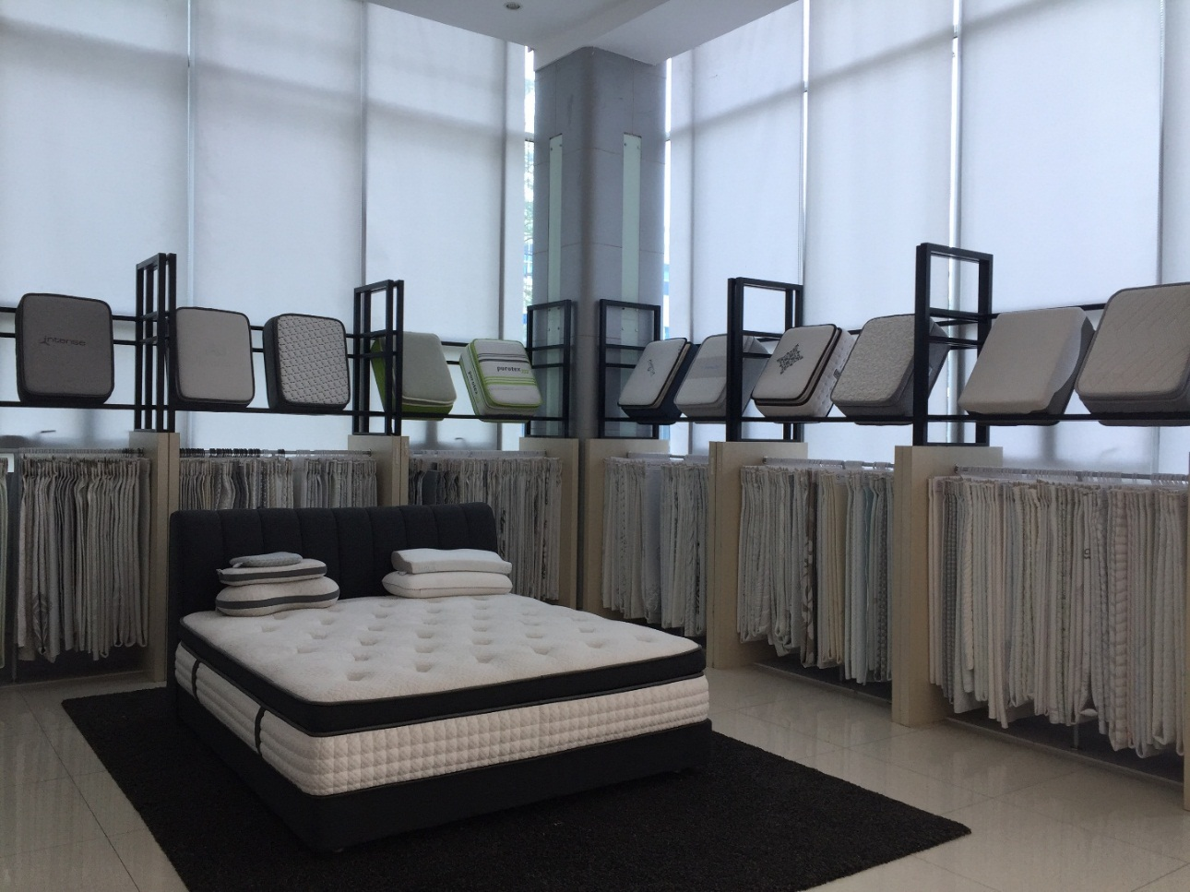
产品展示厅

Slide 24
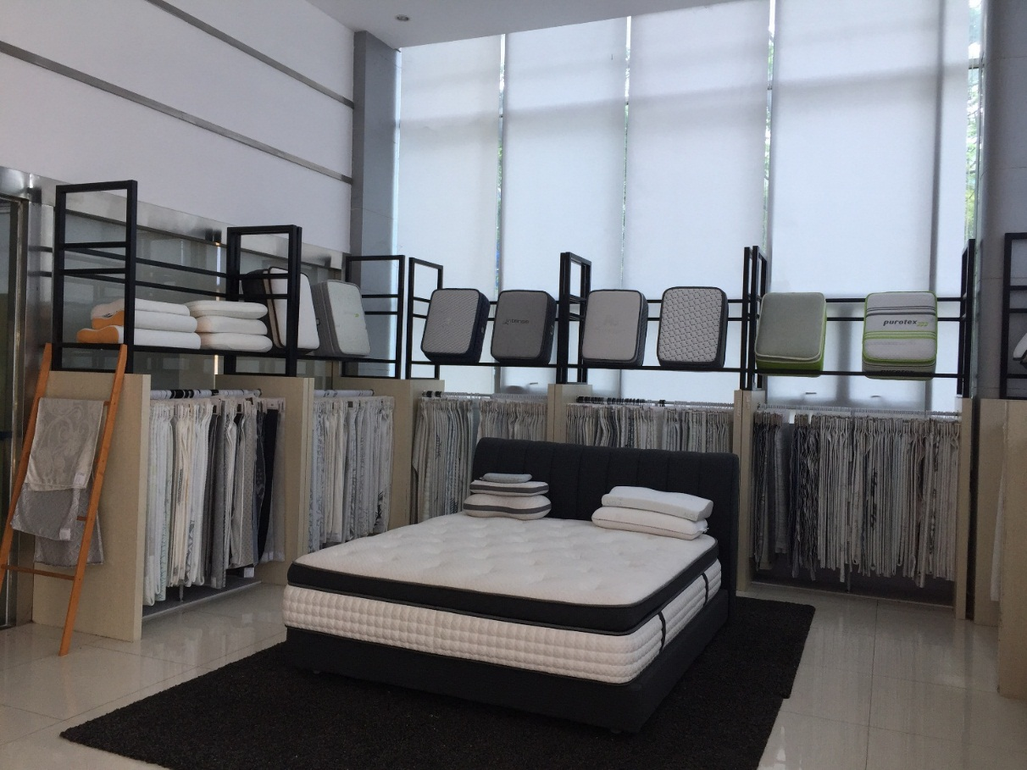
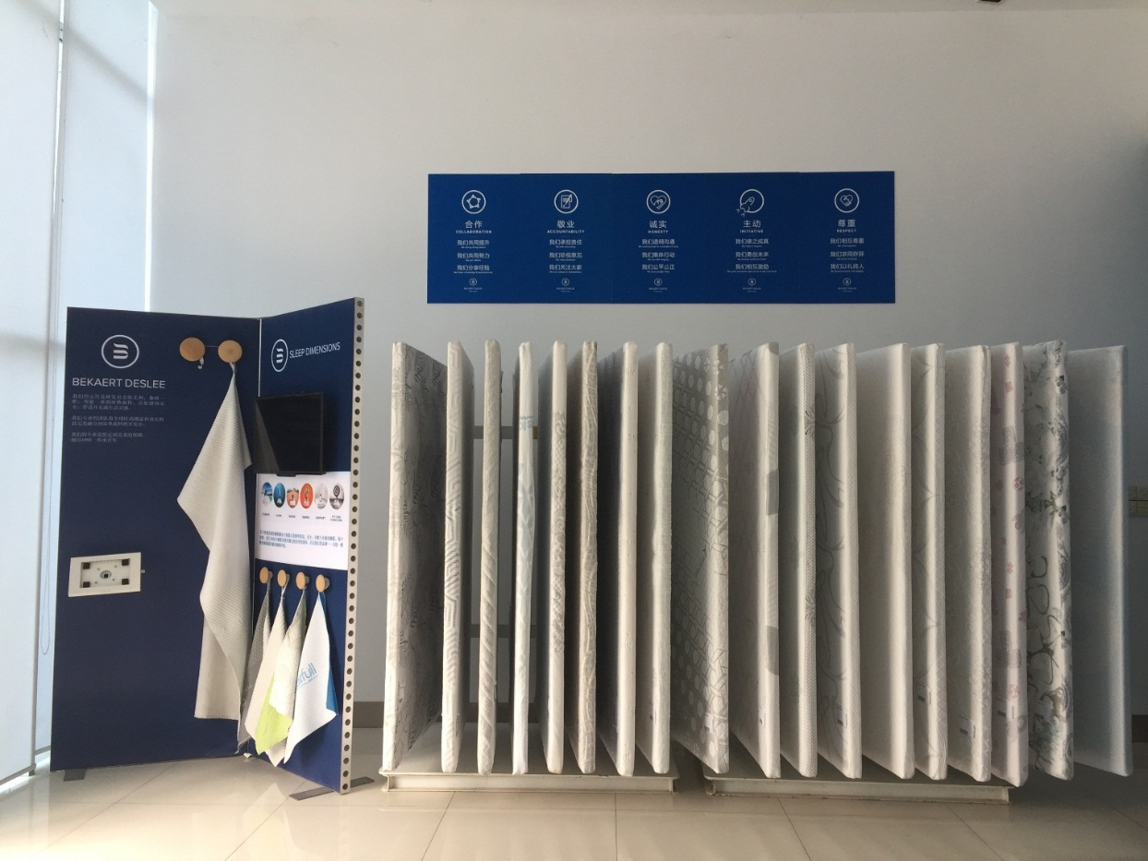
产品展示厅

Slide 25
Expertise in woven & knitted fabrics
专注生产针织和梭织面料

Slide 26
Design that matters
设计的重要
Four key styles of the BekaertDeslee Collection mixed with emerging trends cover the world of different tastes.
从世界各地搜罗最新潮流趋势并将之融合，贝卡特德思丽旗下主要有四种设计风格 。
Within each of these styles, the BekaertDeslee design team has developed several themes or stories that translate perfectly the hot trends of today and tomorrow and meet every customer or consumer in his own style.
在每种风格下，我们的设计团队更细分了不同的侧重点，保证能满足不同客户的需求。

Slide 27
Pure
Styles

Slide 28
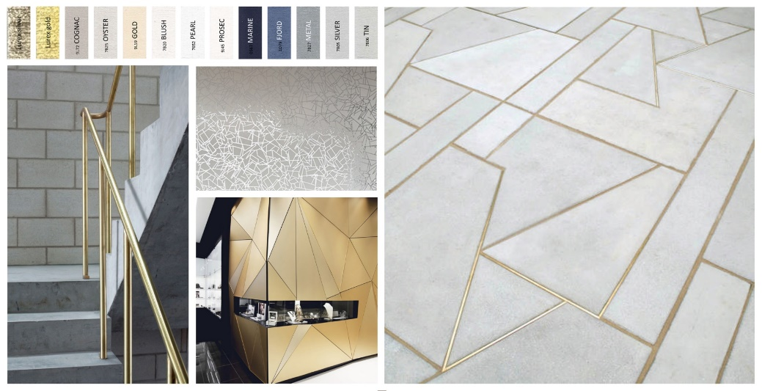
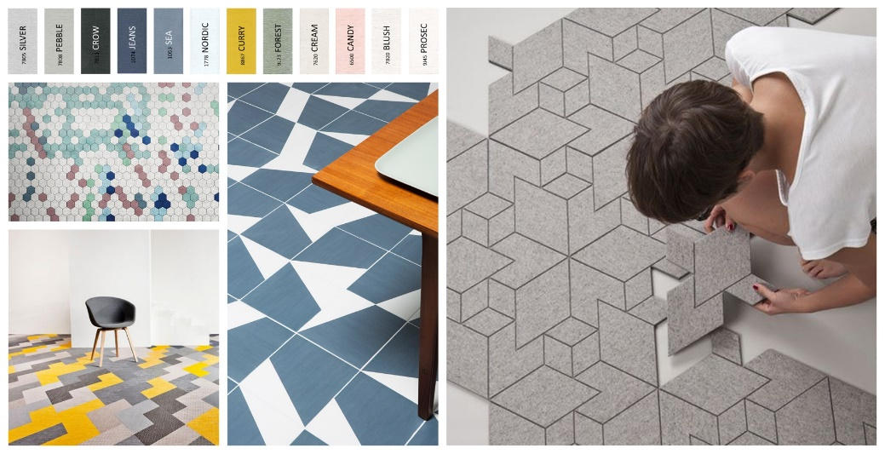
Fusion
Styles

Slide 29
Nuance
Styles

Slide 30
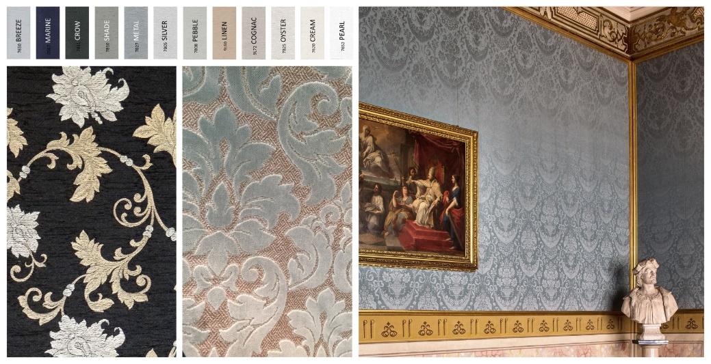
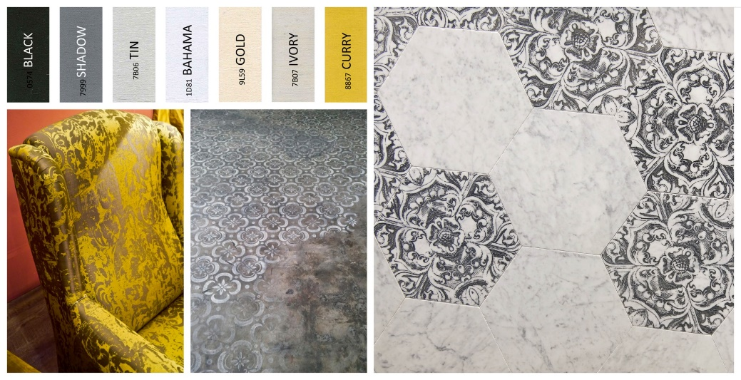
Classic
Styles

Slide 31
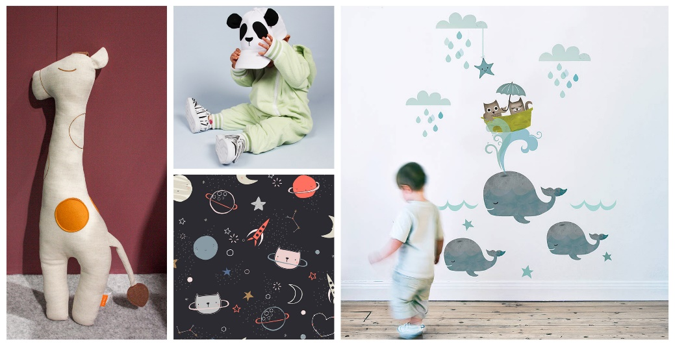
Plus
Styles

Slide 32
BekaertDeslee
SleepDimensions
贝卡特德思丽睡眠解决方案
6 brand dimensions full of solutions
for your customer’s specific
sleeping need.
六大睡眠解决方案 满足客户不同需求

Slide 33
CLIMATE
Sleep cool & dry!
营造干爽凉快的睡眠
Specifically engineered textiles optimize temperature and reduce humidity.
独家定制面料
优化睡眠温度并减少湿度
旗下品牌：
Adaptive
Tencel
Cairfull
SensIce
等等
CLIMATE

Slide 34
CLEAN
Sleep fresh & clean
打造清新洁净的睡眠
Mattress textiles for a long lasting hygienic sleep environment.
全新的床垫纺织面料
带来长效的洁净睡眠环境
旗下品牌：
Purotex
Lotus
Fresche
Hycare/Sanitized
Argentum+
等等
CLEAN

Slide 35
REVIVE
Energize your body
释放身体能量的睡眠
High-tech sleep surfaces that recharge your batteries for an active life.
蕴含科技含量的床垫面料
为多彩生活注入无限能量
旗下品牌：
Intense
Nanobionic
Celliant
SKIN+
等等
REVIVE

Slide 36
SENSES
Awake your senses
唤醒愉悦感官的睡眠
Stylish, soft, scented textiles that trigger all your senses.
独树一帜，柔软馨香的床垫面料
给您带来全新的感官享受
旗下品牌：
Real Silk
Finesse
SensIce
Cashmere
SENSES

Slide 37
SUPPORT
Support your back
提供有效承托的睡眠
Flexible textiles that adapt to the shape of your body.
弹性卓越的床垫面料
为身体调节最合适的睡眠弧度
旗下品牌：
Bodyfit
Cairfull
Biaxial
等等
SUPPORT

Slide 38
FIT FOR FUNCTION
Try our clever solutions
定制集约高效的睡眠
We offer B2B expertise through customized technologies.
运用独家定制科技
为B2B提供最专业的解决方案
旗下品牌：
AntiSlip
Fire Safety
PILLINGPROOF
FIT FOR FUNCTION

Slide 39
Agenda
BekaertDeslee Overview
BD Fresh Graduate Program

Slide 40
What is BDCN Fresh Graduate Plan?
a Fast –Track development journey from a student to a professional
Reach first career goal by professional way
Develop own career interest
Get the talent BDCN needs
Train competent successor
Gain fresh blood to make BDCN energetic and dynamic

Slide 41
Development Module
Assignments
Special Projects
Task Forces
Delegated Work
Work in Untested Areas
70%
On The Job
20%
People
10%
Study
Feedback
Coaching
Mentoring
Observation of Others
Role Models
Resources
Training Programs

Slide 42
BDCN Fresh Graduate Plan
Stage 1
Fit In
Rotation
Coaching
Networking
Performance Management
Career plan
Stage 2
Independent
Solid training and development plan
Stage 3
Stand Out

Slide 43
Talent Management Process
Talent management process
Performance management
Growth potential identification
Risk assessment
Succession plan

Slide 44
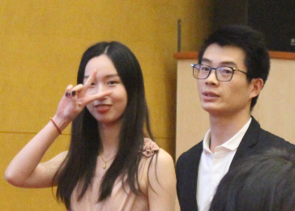
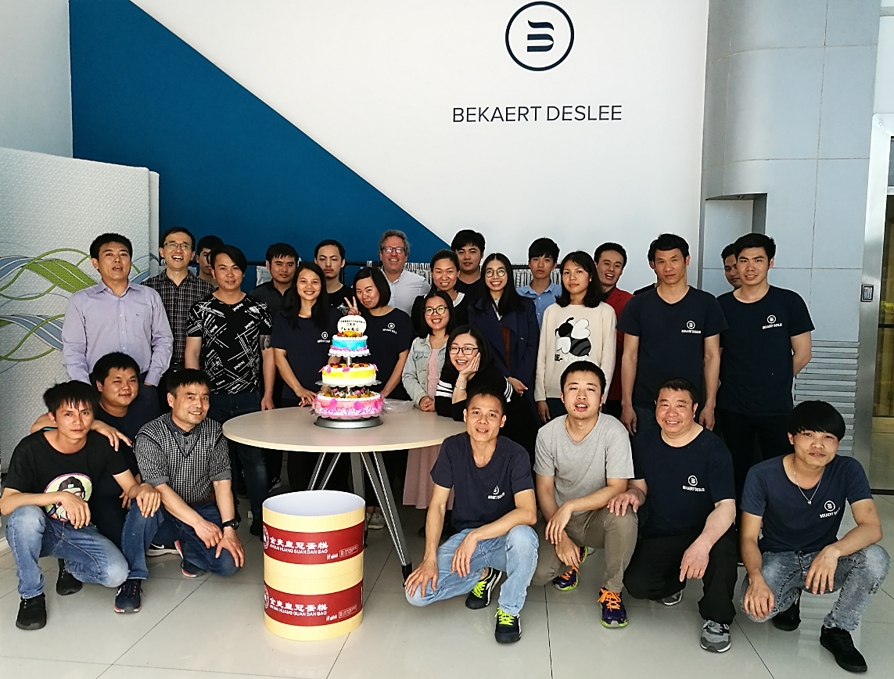
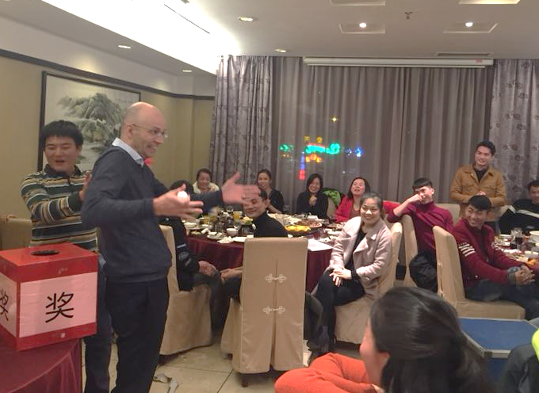
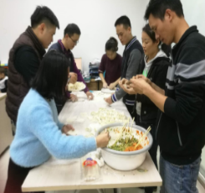
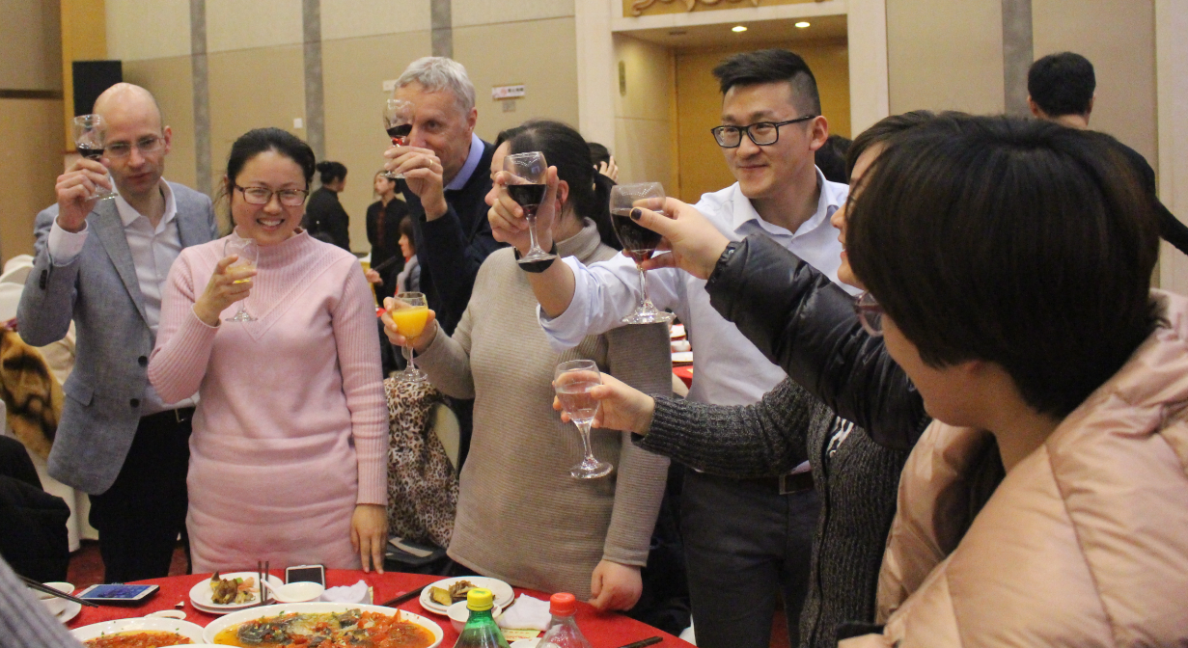
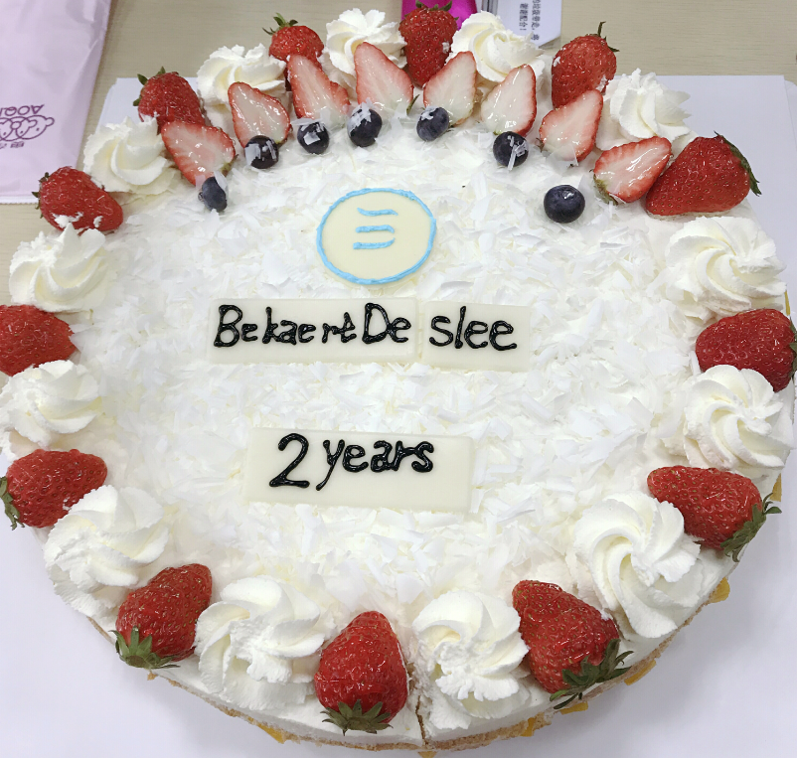
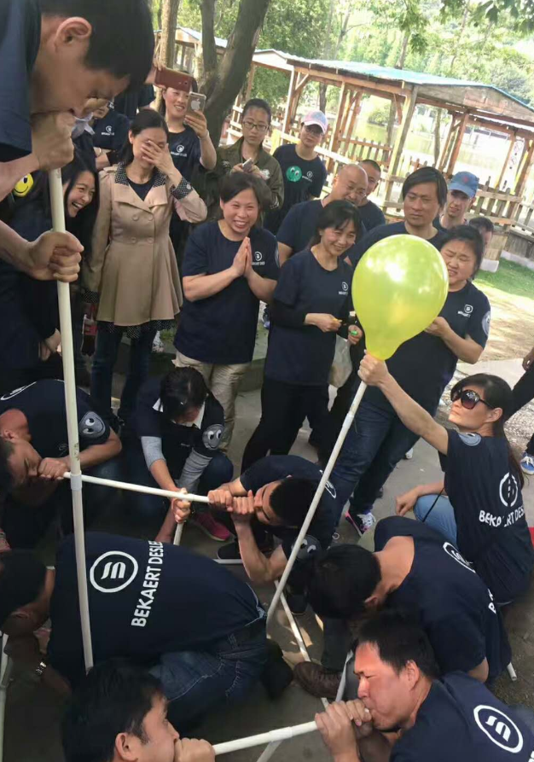
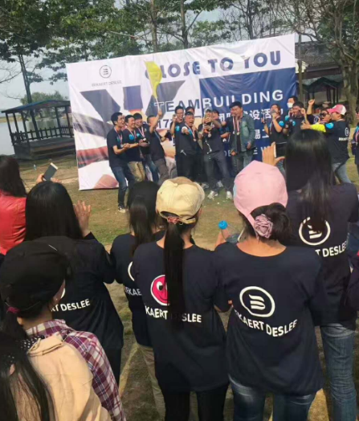
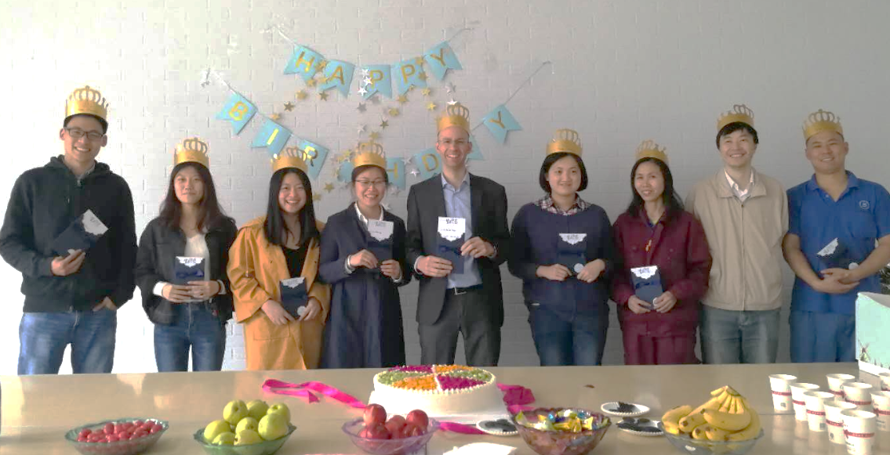
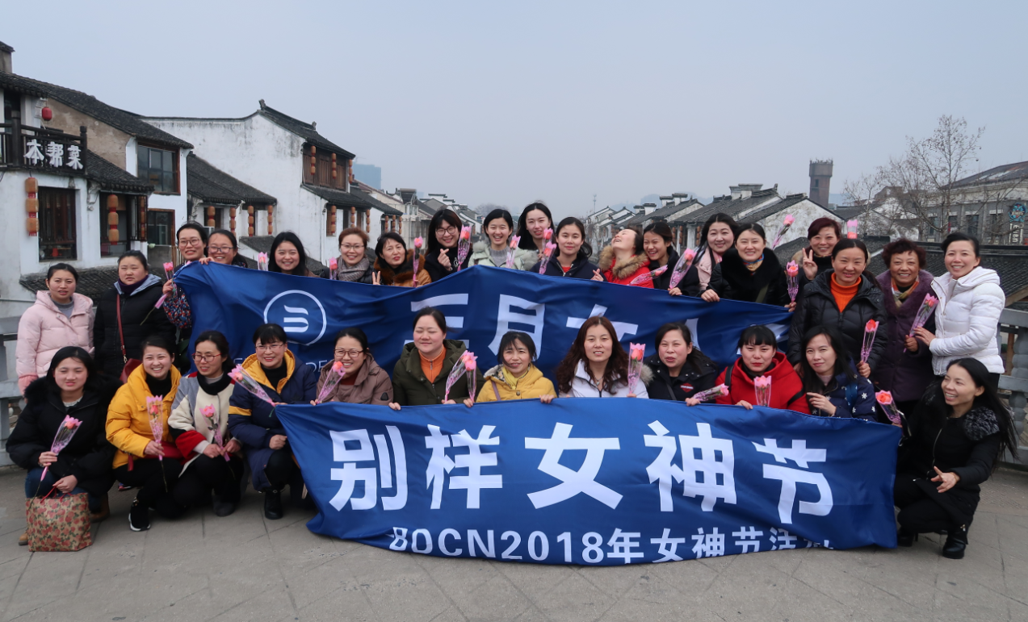
Life in BDCN

Slide 45
C&B
生活补助，实习阶段
免费工作餐
交通补助
健康体检
团队活动
节日礼金
商业保险

Slide 46
Our Needs
编号 | 岗位名称 | 部门 | 专业要求 | 学历要求 | 职位需求 | 工作地点
1 | 纺织工程师 | 运营 | 纺织工程 | 本科 | 3 | 无锡
2 | 销售代表 | 销售 | 纺织工程 | 本科 | 2 | 无锡
3 | 面料设计师 | 销售 | 纺织设计 | 本科 | 1 | 无锡

Slide 47
www.bekaertdeslee.com

