Slide 1
Academic reading II
Chapter 1

Slide 2
About this course
1. An introduction to academic English
2. Who are the course aimed at?
3. What approach is adopted in this course?
4. Critical thinking
5. Aims of improving your academic reading and writing abilities.

Slide 3
How do we understand academic?
Narrow sense: related to researches in
various fields
Broad sense: related to education we receive
in educational institutions
including colleges and universities.

Slide 4
Academic English
Most of the materials used will normally be on academic topics
Examples of vocabulary which are typically academic and types of language structures commonly found in academic texts
students will be exposed to language which is directly relevant to their specific fields of study, the texts chosen which are more directly relevant to their areas of study
E.g. 学业英语 （linguistics, phonetics, literature, translation for English majors)
学术 (研究）英语（thesis, papers, reports, dissertation for research in a specific field )

Slide 5
students are more often to read a selection of different texts on the same topic.
students are often expected to research the topic themselves and so need to develop the habit of reading around the subject
students also need to learn how to analyze what they are reading, to read and think critically about content and style and argument put forward by the writer.

Slide 6
The textbook:
Academic Encounters: Life in Society, Reading and Writing
By Jessica Williams & Kristine Brown & Susan Hood
Academic Encounters: Human Behavior
By Bernard Seal

Slide 7
2. Who are the course aimed at?
Academic Encounters: Life in society
is a reading, study skills, and writing text based on material taken from sociology textbooks used in North American and other English-speaking colleges and universities.
It is written for the students who has either just started or is about attending a college or university.

Slide 8
Academic Encounters: Human Behavior
Focuses on research findings and theories in psychology and human commnicaions.
The book are designed for students at the low-advanced to advanced level.

Slide 9
-- This textbook contains 4 units, each unit contains 2 chapters, each chapter covers 4 parts,
R (reading skills)/ W (writing skills)/
V (vocabulary skills)/A (academic success skills)
Preparing to read/Now read/After read
Writing assignments/Unit content quiz(in teacher’s manual)
--supplementary materials related to the theme of each unit may be provided for students who want to do further reading on the theme. PS. Especially texts from CET 6.

Slide 10
3. What approach is adopted in this course?
Content-based approach (Page ix)
student interaction
presentation
group study
discussion
Comprehensive reading VS Integrated reading
shifts of learning focus

Slide 11
Critical thinking
The ability to apply reasoning and logic to new or unfamiliar ideas, opinions, and situations. Thinking critically involves seeing things in an open-minded way and examining an idea or concept from as many angles as possible.

Slide 12
Recognizing variation across academic subjects
Different academic subjects are interested in different topics and consequently use different methods of working and ways of talking and writing about their works.

Slide 13
Focusing on academic vocabulary
General vocabulary (e.g 3500 words for middle school students, 4200+for CET4, 5500+for CET6, 8000 for Band 4 and 13000 for Band 8)
Academic vocabulary
(Academic Word List https://www.shanbay.com/wordbook/6673/)
Specialized vocabulary (medicine, chemical, trade )

Slide 14
Aim of this course 1
To Promote faster reading (3-7minutes to read a text )
To familiarize with the content of reading, and to think critically about the topic.
To introduce reading strategies, and give students tools when they encounter some similar reading assignments.
To develop writing skills such as summarizing and paraphrasing.

Slide 15
Aim of this course 2
How to read academic texts
Ways to think critically about what you read
How to write in an academic style
Methods of preparing for tests
Strategies for dealing with new vocabulary
Note-taking and study techniques

Slide 16
Requirement
Understanding lectures
Taking part in group work
Giving presentations
Reading academic texts
Finding information to include in your writing
Writing essays
Summarizing what you’ve learnt
Learning academic vocabulary

Slide 17
Curriculum arrangement and teaching design:
-- 12 weeks (3-14) for 6 units
-- 3 periods per week
-- 5-6 periods of class for each chapter

Slide 18
Requirements for the students (how to follow this course):
-- before class: preview the textbook; theme-related reading; Questions concerned the topic.
-- in class: reading attentively and finish the exercises; think actively; work in pairs or in groups in reading tasks; taking notes while listening or reading;
-- after class: project; homework;

Slide 19
Group division:
Group division: the class is divided into several groups, each group containing several students, and the project or homework will be largely based on groups or pairs or students within groups.

Slide 20
How to calculate the final score:
-- The final score of this course is based on students’ daily performance and the final examination mark. The ratio between your daily performance and your score in the final examination is about 1/1

Slide 21
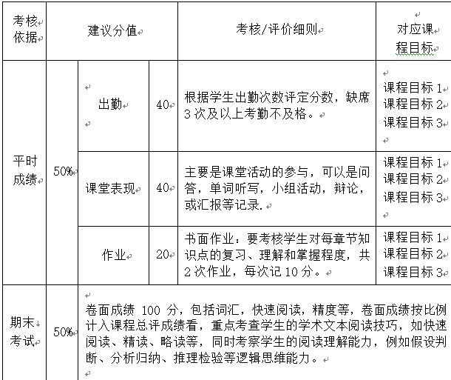
课程考核方法

Slide 22
An interview for the students (in class) & Feedback:
What do you expect to learn through this course?
After listening to the course introduction made by T, do you have any questions, doubts and suggestions about this course?

